Slide 1

Data Manipulation and Preprocessing Using Pandas and Python Libraries
Supervised by:
Dr. Krishnaraj M
Presented by:
S.Sirivally
192472371

Slide 2
Introduction
What is Data Manipulation?
Data manipulation is the process of organizing, cleaning, transforming, and analyzing raw data.
It helps convert unstructured data into a meaningful format.
What is Data Preprocessing?
Data preprocessing prepares raw data before analysis.
It improves data quality by removing errors and inconsistencies.
Why is it Important?
Improves accuracy
Removes duplicate or missing data
Makes analysis faster
Produces reliable results

Slide 3
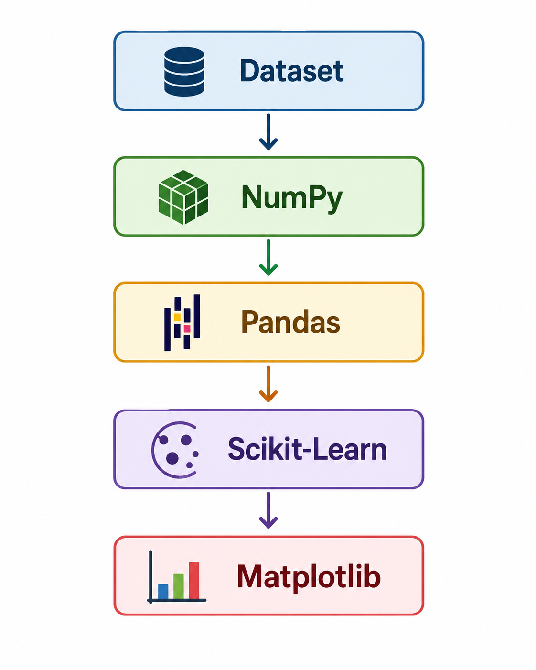
Libraries for Data Manipulation and Preprocessing
Library | Purpose
NumPy | Numerical computations and array operations
Pandas | Data manipulation and preprocessing
Matplotlib | Data visualization
SciPy | Scientific and statistical computations
Scikit-Learn | Data preprocessing and machine learning utilities
Workflow

Slide 4
Data Manipulation Using Pandas
What is Pandas?
Pandas is an open-source Python library used for data analysis and manipulation.
Features
Read CSV/Excel files
Create DataFrames
Select data
Filter rows
Sort data
Group records
Rank data
Export processed data
Example:
import pandas as pd
df = pd.read_csv("students.csv")
print(df.head())

Slide 5
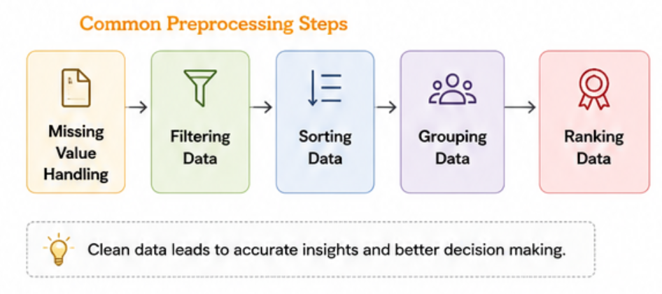
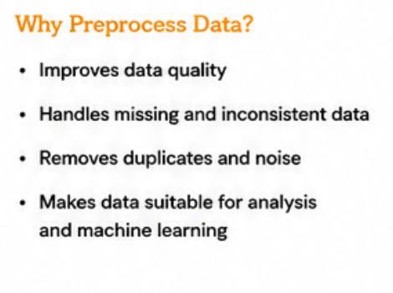
Data Preprocessing Techniques

Slide 6
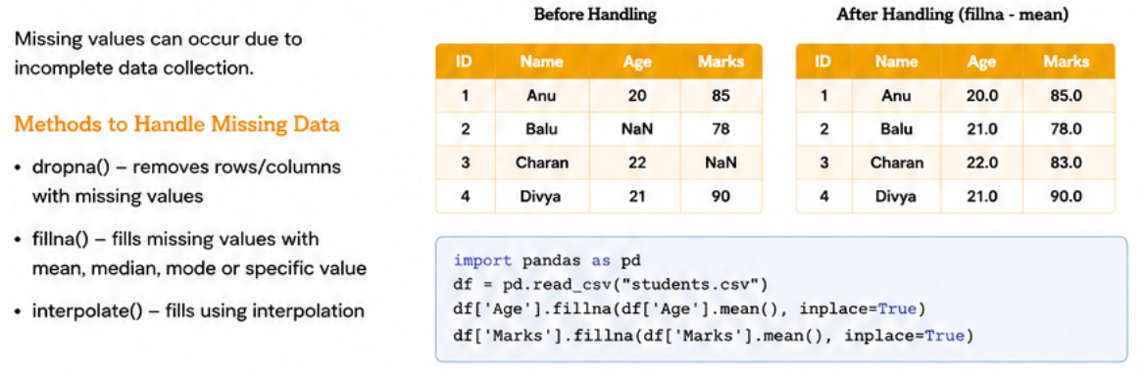
Handling Missing Data

Slide 7
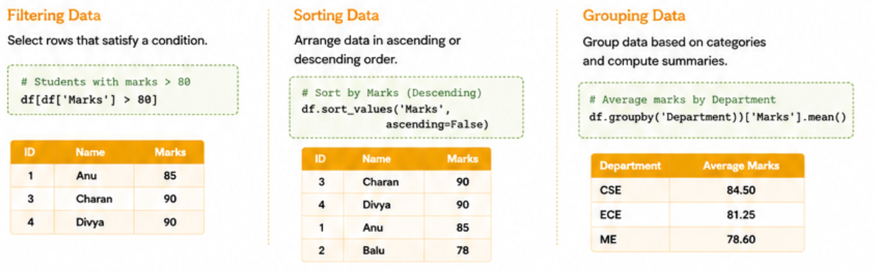
Filtering, Sorting and Grouping Data

Slide 8
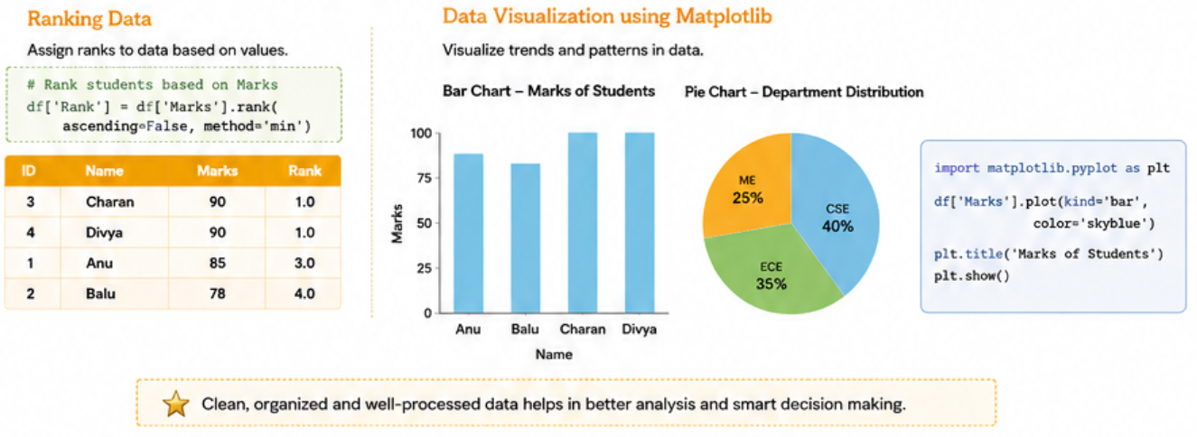
Ranking and Visualization

Slide 9
Real-Time Applications
Domain | Application
🏥 Healthcare | Cleans patient records for accurate diagnosis and treatment.
🏦 Banking | Preprocesses transaction data to detect fraudulent activities.
🛒 Retail | Analyzes customer and sales data to improve business decisions.
🎓 Education | Evaluates student performance and academic trends.
🌾 Agriculture | Processes crop and weather data for yield prediction.
🏭 Manufacturing | Organizes production data to improve quality control.
Key Takeaway:
Data preprocessing helps organizations make faster, more accurate, and data-driven decisions.

Slide 10
Conclusion
Data manipulation and preprocessing are the foundation of every data analysis project.
Pandas simplifies reading, cleaning, filtering, sorting, grouping, and ranking data.
NumPy, SciPy, Scikit-Learn, and Matplotlib extend Pandas by providing numerical computing, preprocessing techniques, scientific analysis, and visualization.
Combining these libraries creates an efficient workflow for preparing high-quality data for analysis and machine learning.
Final Note
"Well-preprocessed data leads to reliable analysis, better visualizations, and smarter decision-making."

Slide 11



